Slide 1

Application Layer: Overview
socket programming with UDP and TCP
Principles of network applications
Web and HTTP
E-mail, SMTP, IMAP
The Domain Name System DNS

Slide 2

Socket programming
goal: learn how to build client/server applications that communicate using sockets
socket: door between application process and end-end-transport protocol
application
socket
application
controlled by
app developer
process
process
transport
transport
network
network
controlled
by OS
link
Internet
link
physical
physical

Slide 3
Socket programming
In computer networks, communication happens between processes on different or same hosts.
IP Addresses identify devices; Port Numbers identify processes.
Example: 192.168.1.10:80
IP for the host: 192.168.1.10
Port for the webserver process: 80
A socket is an endpoint for communication between two processes. It abstracts network communication and provides APIs for sending and receiving data.

Slide 4
Socket programming
Application Example:
client reads a line of characters (data) from its keyboard and sends data to server
server receives the data and converts characters to uppercase
server sends modified data to client
client receives modified data and displays line on its screen

Slide 5
Socket programming
Two socket types for two transport services:
UDP: unreliable
Datagram Sockets (SOCK_DGRAM)
TCP: reliable
Stream Sockets (SOCK_STREAM)
Address families:
AF_UNIX (local), if you want to use sockets on the same host.
AF_INET (network), if you want to use sockets on the network.

Slide 6
Socket programming
sockaddr_in structure:
This structure is used to store Internet Protocol (IP) addresses and port numbers for network communication. Think of it as the "address label" for a network endpoint.
struct sockaddr_in {
short int sin_family; // Address family (e.g., AF_INET)
unsigned short int sin_port; // Port number
struct in_addr sin_addr; // IP address
unsigned char sin_zero[8]; // Padding (not used, but for size alignment)
};
struct in_addr {
unsigned long int s_addr; // IP address in network byte order
};

Slide 7
Socket programming with TCP
Client must contact server
server process must first be running
server must have created socket (door) that welcomes client’s contact
Client contacts server by:
Creating TCP socket, specifying IP address, port number of server process
when client creates socket: client TCP establishes connection to server TCP
when contacted by client, server TCP creates new socket for server process to communicate with that particular client
allows server to talk with multiple clients
source port numbers used to distinguish clients (more in Chap 3)
Application viewpoint
TCP provides reliable, in-order
byte-stream transfer (“pipe”)
between client and server processes

Slide 8
Socket programming – Server (TCP)
socket()
First, a server application creates a socket, which like a file descriptor, is a resource assigned to the server process and that process alone.
bind()
Next, the server process gives the socket a name.
listen()
The server process then waits for a client to connect to the named socket.
listen() creates a queue for incoming connections.
accept()
The server can accept them using the system call accept().

Slide 9
Socket programming – Server (TCP)
When the server calls accept(), it blocks.
An incoming client connection unblocks accept().
A new socket is created and returned by accept() is
Distinct from the named (server) socket.
This new socket is used solely for communication with the particular client.
NOTE: The named socket (created in the start) remains intact to intercept more client connections.

Slide 10
Socket programming – Client (TCP)
socket()
The client side of a socket-based system is more straightforward. The client creates an unnamed socket by calling socket().
connect()
It then calls connect() to establish a connection with the server by using the server’s named socket as an address.
Once established, sockets can be used like low-level file descriptors, providing two-way data communications.

Slide 11
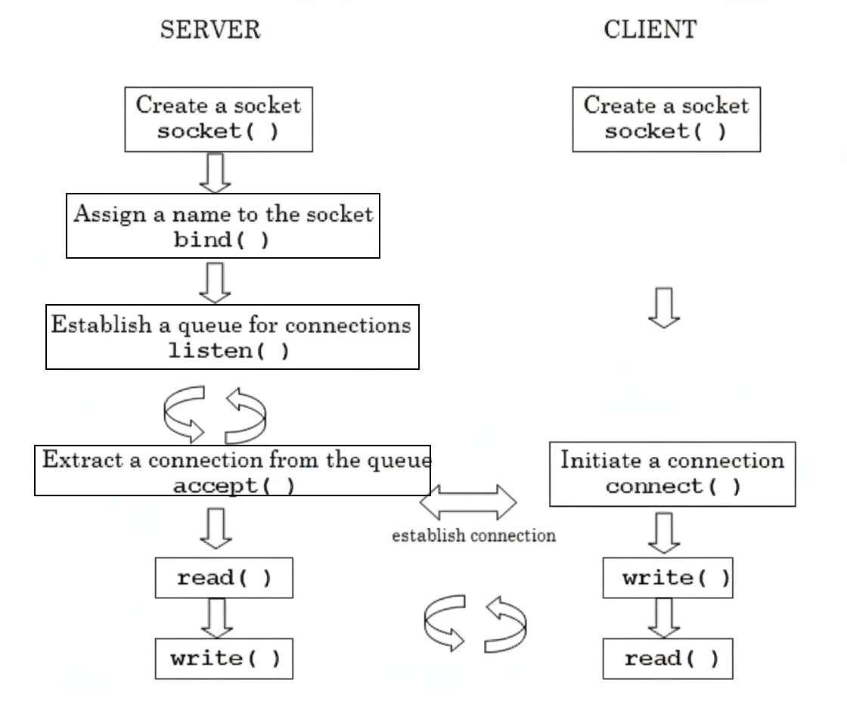

Slide 12
Client/server socket interaction: TCP
int main()
{
int S_sockfd, C_sockfd;
int S_len, C_len;
struct sockaddr_in S_address;
struct sockaddr_in C_address;
int result;
char ch='A';
S_sockfd = socket(AF_INET, SOCK_STREAM, 0);
S_address.sin_family = AF_INET;
S_address.sin_addr.s_addr = inet_addr("127.0.0.1");
S_address.sin_port = htons(9734);
S_len = sizeof(S_address);
bind(S_sockfd, (struct sockaddr *) &S_address, S_len);
listen(S_sockfd, 5);
host-to-network-short converts 16bit integer from host byte order to network byte order
server

Slide 13
Client/server socket interaction: TCP
while(1)
{
char ch;
printf("Server %d waiting\n", getpid());
C_len = sizeof(C_address);
C_sockfd = accept(S_sockfd, (struct sockaddr *)&C_address, &C_len);
if (C_sockfd == -1){
perror("accept");
continue; // Continue to next iteration instead of exiting
}
result = read(C_sockfd, &ch, 1);
if (result == -1){
perror("read");
close(C_sockfd);
continue;
}
ch++;
result = write(C_sockfd, &ch, 1);
if (result == -1){
perror("write");
}
close(C_sockfd);
}
close(S_sockfd);
exit(0);
}
server

Slide 14
Client/server socket interaction: TCP
int main()
{
int sockfd;
int len;
struct sockaddr_in address;
int result;
char ch='A';
sockfd = socket(AF_INET, SOCK_STREAM, 0);
address.sin_family = AF_INET;
address.sin_addr.s_addr = inet_addr("127.0.0.1");
address.sin_port = htons(9734);
len = sizeof(address);
result = connect(sockfd, (struct sockaddr *)&address, len);
if (result == -1){
perror("client3");
exit(1);
}
write(sockfd, &ch, 1);
read(sockfd, &ch, 1);
printf("char from server = %c\n", ch);
close(sockfd);
exit(0);
}
host-to-network-short converts 16bit integer from host byte order to network byte order
client

Slide 15
Socket programming with UDP
UDP: no “connection” between client and server:
no handshaking before sending data
sender explicitly attaches IP destination address and port # to each packet
receiver extracts sender IP address and port# from received packet
UDP: transmitted data may be lost or received out-of-order
Application viewpoint:
UDP provides unreliable transfer of groups of bytes (“datagrams”) between client and server processes

Slide 16
Client/server socket interaction: UDP
int main()
{
int S_sockfd;
int S_len, C_len;
struct sockaddr_in S_address;
struct sockaddr_in C_address;
int result;
char ch='A’;
S_sockfd = socket(AF_INET, SOCK_DGRAM, 0);
S_address.sin_family = AF_INET;
S_address.sin_addr.s_addr = inet_addr("127.0.0.1");
S_address.sin_port = htons(9734); // Added htons() for proper byte order
S_len = sizeof(S_address);
bind(S_sockfd, (struct sockaddr *) &S_address, S_len);
host-to-network-short converts 16bit integer from host byte order to network byte order
server

Slide 17
Client/server socket interaction: UDP
while(1)
{
char ch;
printf("Server %d waiting\n", getpid());
C_len = sizeof(C_address);
result = recvfrom(S_sockfd, &ch, 1, 0, (struct sockaddr *)&C_address, &C_len);
if (result == -1)
{
perror("recvfrom");
continue; // Continue to next iteration instead of exiting
}
ch++;
result = sendto(S_sockfd, &ch, 1, 0, (struct sockaddr *)&C_address, C_len);
if (result == -1)
{
perror("sendto");
}
// No need to close C_sockfd - UDP uses same socket for all clients
}
close(S_sockfd);
exit(0);
}
server

Slide 18
Client/server socket interaction: UDP
int main()
{
int sockfd, len;
struct sockaddr_in address;
int result;
char ch='A’;
sockfd = socket(AF_INET, SOCK_DGRAM, 0);
address.sin_family = AF_INET;
address.sin_addr.s_addr = inet_addr("127.0.0.1");
address.sin_port = htons(9734);
len = sizeof(address);
result = sendto(sockfd, &ch, 1, 0, (struct sockaddr *)&address, len);
if (result == -1)
{
perror("client3");
exit(1);
}
result = recvfrom(sockfd, &ch, 1, 0, (struct sockaddr *)&address, &len);
if (result == -1)
{
perror("client3");
exit(1);
}
printf("char from server = %c\n", ch);
close(sockfd);
exit(0);
}
host-to-network-short converts 16bit integer from host byte order to network byte order
client

Slide 19
Chapter 2: Summary
our study of network application layer is now complete!
application architectures
client-server
P2P
application service requirements:
reliability, bandwidth, delay
Internet transport service model
connection-oriented, reliable: TCP
unreliable, datagrams: UDP
specific protocols:
HTTP
SMTP, IMAP
DNS
socket programming:
TCP, UDP sockets

Slide 20
Chapter 2: Summary
Most importantly: learned about protocols!
typical request/reply message exchange:
client requests info or service
server responds with data, status code
message formats:
headers: fields giving info about data
data: info(payload) being communicated
important themes:
centralized vs. decentralized
stateless vs. stateful
scalability
reliable vs. unreliable message transfer
“complexity at network edge”

Slide 21
Questions

Slide 22
Socket Programming
int socket(int domain, int type, int protocol);
Creates a new socket (communication endpoint).
domain: Address family (e.g., AF_INET, AF_UNIX).
type: Communication type (SOCK_STREAM for TCP, SOCK_DGRAM for UDP).
protocol: Usually 0 (system chooses default).
int bind(int sockfd, const struct sockaddr *addr, socklen_t addrlen);
Assigns a local address (IP + port) to the socket.
sockfd: The socket descriptor.
addr: Address structure (e.g., sockaddr_in).
addrlen: Size of address structure.

Slide 23
Socket Programming
int listen(int sockfd, int backlog);
Marks the socket as passive (server) and sets up a connection queue.
sockfd: Bound TCP socket.
backlog: Max number of pending connections allowed.
int accept(int sockfd, struct sockaddr *addr, socklen_t *addrlen);
Extracts the first connection request from the queue.
sockfd: Listening socket.
addr: Filled with client’s address info.
addrlen: Input = size of structure, Output = actual size returned.
Returns new socket descriptor for that client.

Slide 24
Socket Programming
int connect(int sockfd, const struct sockaddr *addr, socklen_t addrlen);
Initiates a connection on a socket.
sockfd: Your TCP client socket.
addr: The server's address (IP + port) to connect to.
addrlen: Size of the server's address structure.
Purpose: For TCP clients, this function actively attempts to establish a connection with a listening server. Once successful, sockfd is then connected to the server.

Slide 25
Socket programming with UDP – sendto/recvfrom
ssize_t sendto(int sockfd, const void *buf, size_t len, int flags, const struct sockaddr *dest_addr, socklen_t addrlen);
ssize_t recvfrom(int sockfd, void *buf, size_t len, int flags, struct sockaddr *src_addr, socklen_t *addrlen);
ssize_t → return value = number of bytes sent/received, or -1 on error.
sockfd → socket descriptor (must be UDP for connectionless use).
buf/len → actual data buffer and its size.
flags → usually 0.
dest_addr/addrlen (sendto) → specify recipient’s IP + port.
src_addr/addrlen (recvfrom) → filled in with sender’s IP + port.

